Slide 1
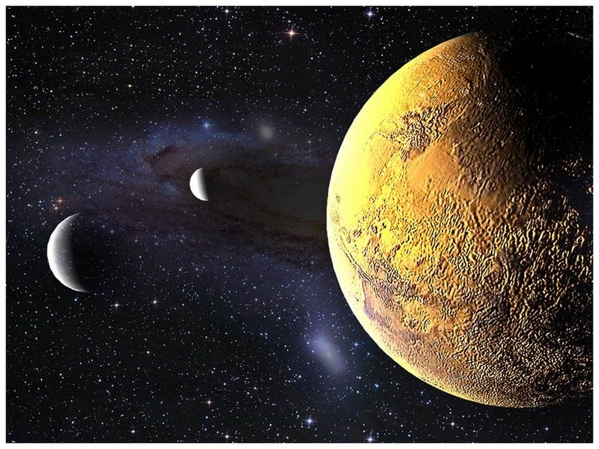
S.O.L.I.D.
Landing on Solid Ground
Philip Jordan
Nicolas Martin
Alec Deitz
Jason Alexander

Slide 2


Workshop Format
Katas
Mars Rover
Lightning talk followed by exercise
Single Responsibility Principle
Open/Closed Principle
Liskov Substitution and Interface Segregation Principles
Dependecy Inversion
Introduced by Robert Martin (Uncle Bob) in
Principles of Object Oriented Design
Notes:
Principles of OO Design - 2003

Slide 3
S.O.L.I.D.
Single Responsibility Principle

Slide 4
There should never be more than one reason for a class to change
A class should have all of its services narrowly aligned
Notes:
The same piece of code shouldn’t have to change twice. For instance, a piece of code shouldn’t change if the format changes and the data source changes. It should only be one of these

Slide 5
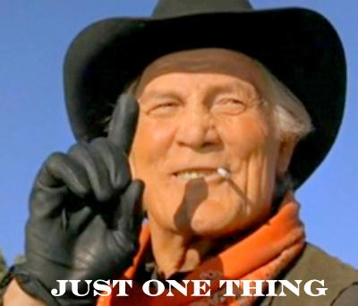
High Cohesion
Robust classes
Improved code reuse
Don’t get lost in the code
Notes:
High cohesion speaks to all the different parts in your classes working together – think of how rover only has rover things

Slide 6
Change Agents
Multiple motivators shouldn’t change the same code
Motivators are often tied to people
Confidence in your code
Notes:
Change agents are pretty much the motivator for changes, usually driven by requirements changes by someone. Want to make sure change agents have their own space

Slide 7

How?
Break it down!
Notes:
Large methods into smaller methods
Large classes into smaller classes
Separate concerns & reassemble

Slide 8
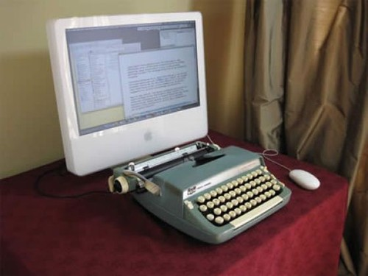
How?
Look for opportunities for reuse
Notes:
Look for patterns
Abstract common functionality

Slide 9
How? Code Smells
Methods of greater than 5 lines
Conjunctions in names: And/Or
More than 3 words in a method
Lines of code in a class
Copy-paste programming
Notes:
Methods should practice SRP too. More than 5 lines means it is probably doing multiple things.
Examples:
LogOrEmailError - see this a lot. Method has 2 paths based on some condition, where the fork leads to 2 separate responsibilities. Although only one responsibility may execute at a time, both responsibilities are coupled to the method.
Example:
ParseInputForDatabase - Probably need code whose responsibility is parsing, and perhaps an abstraction of “Database”. Reminder: look for patterns. If you need to parse for other systems besides the database, consider a polymorphic pattern where each class is responsible for parsing for its own system.
If your class is sufficiently cohesive, you shouldn’t have to keep scrolling around trying to find what you are looking for.
Example:
The account department wants X, Y, and Z fields stored in the database
The IT governance committee insists on columns Y and Z to be encrypted
One class is responsible for persistence (saving to the database) and one class is responsible for securing the data

Slide 10
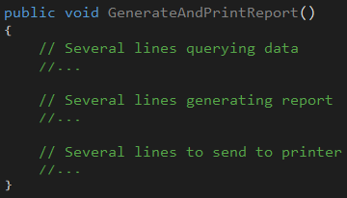
Examples
What happens if….
data store changes?
report format changes?
output changes?
Notes:
Reponsibilities should be separated out to other classes
Consider passing classes that handle other reponsibilities

Slide 11
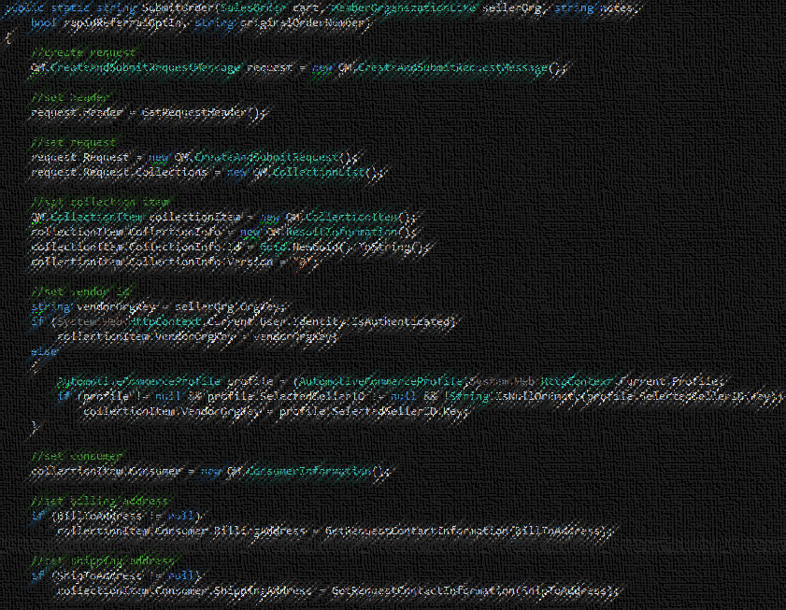
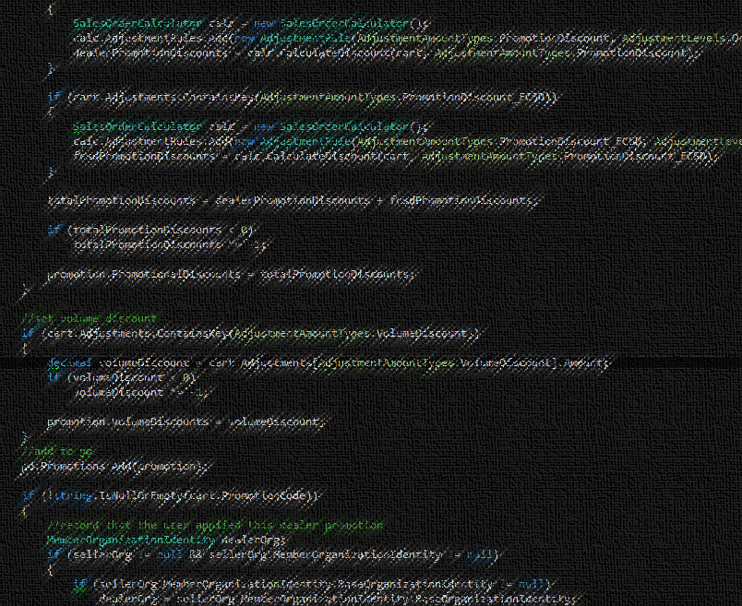
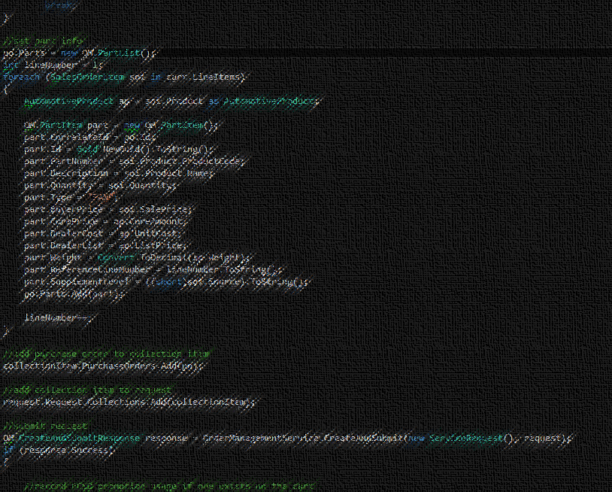
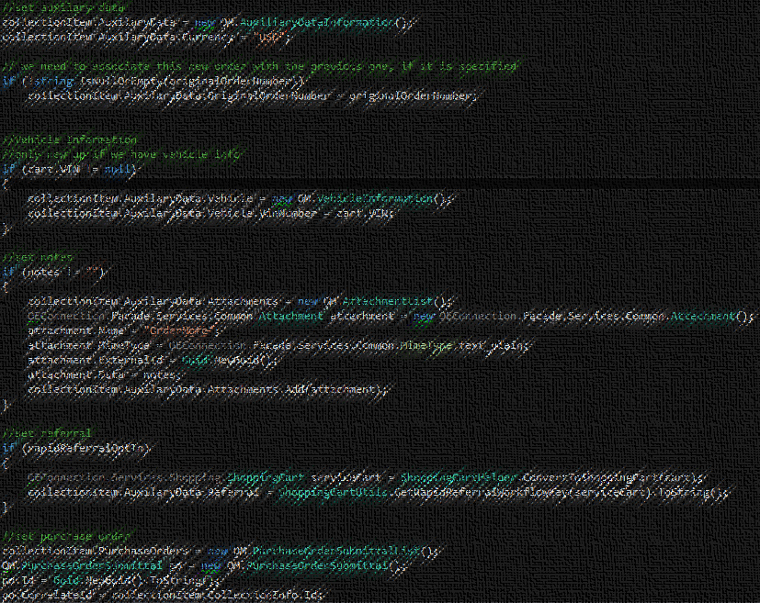
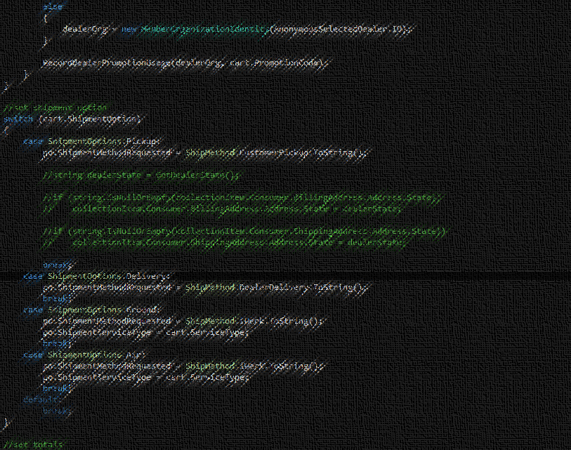
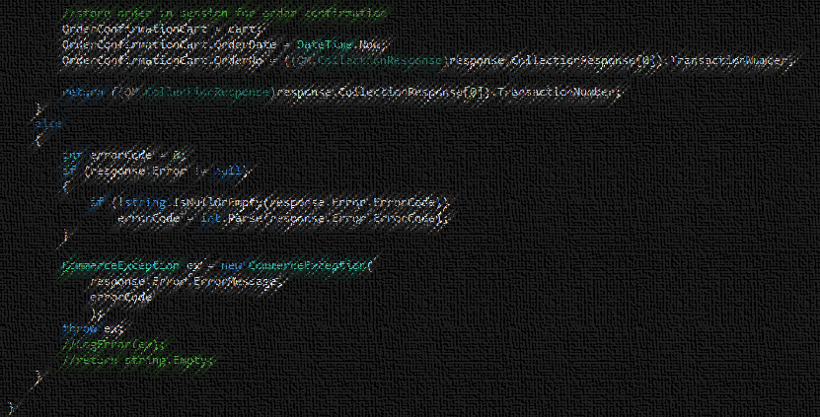
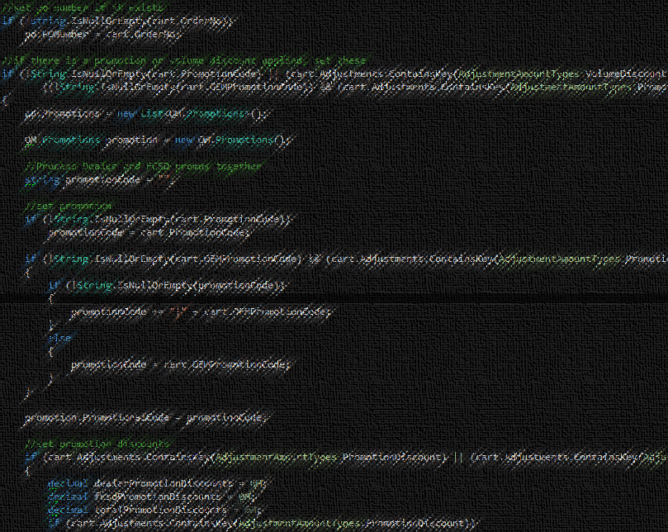
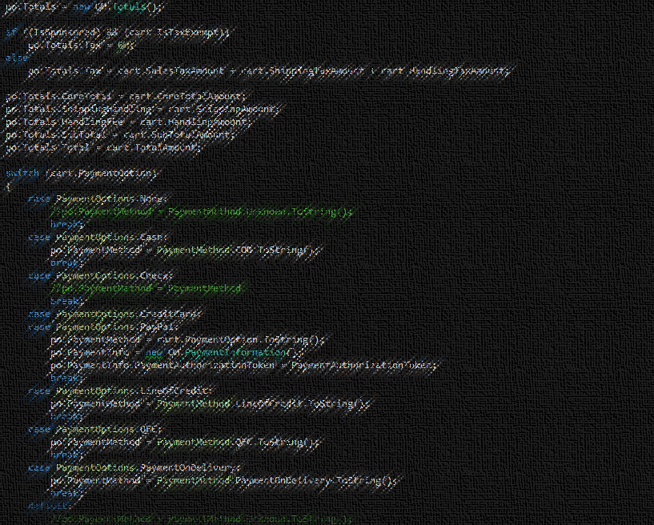
Examples
Fear
Uncertainty
Notes:
157 lines of code – in production.
Many other methods like this
Developers terrified of making changes.

Slide 12
There should never be more than one reason for a class to change
A class should have all of its services narrowly aligned
Notes:
The same piece of code shouldn’t have to change twice. For instance, a piece of code shouldn’t change if the format changes and the data source changes. It should only be one of these

Slide 13
Kata – Mars Rover
.NET and Java
Two functional code bases
One with no respect to SRP
One implemented with SRP in mind
Groups of 3 or 4
Good mix of experience level
Try not to “cheat”
Refer to SRP reference implementation later

Slide 14
Current Rover Responsibilities
Its own movement
Planet’s properties
Managing obstacles
Validating positions
Instructions
Open SRP/[Language]_Exercise
Create Mars class
Move Mars behavior out of the Rover class to a Mars class
Refactor Rover to take a Mars instance in the MissionController class
20 Minutes
- Rover
- Mars
- Mars
- Mars

Slide 15
Possible Solution
Rover
Rover
Mars
Movement
Mars Landing
Boundaries
Coordinates
Obstacles
Separation of concerns
Methods put in classes that make logical sense
Notes:
Talk to these being the types of methods that get split out and not the methods themselves

Slide 16
S.O.L.I.D.
Open/Closed Principle

Slide 17
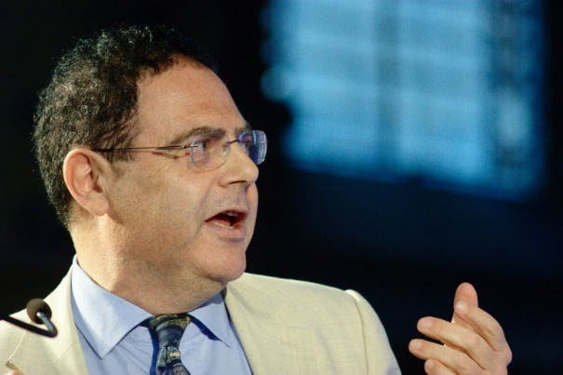
History
Originally credited to Bertrand Meyer in 1988
Open for extension, but Closed for modification
Refined to advocate using abstract base classes
Continually evolving

Slide 18
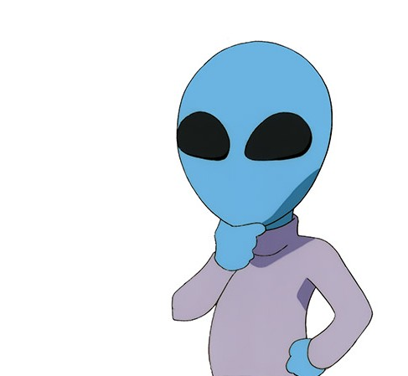
What does it mean?
Concepts at odds with each other
Minimize changes to classes
Open for most probable changes
Notes:
Open means it’s an extension point. Need to strategically pick them.
Open for most probable changes refers to game-planning your classes for where you think changes will happen.
Talk about how you want to minimize code changes in the future.
Refer to a credit card example and how the swipe method would be something you’d want to change.

Slide 19

Benefits
Don’t have to change code once it works
Don’t have to rewrite tests
Doesn’t only apply to base classes
Notes:
In a perfect world, Tests and hopefully applying these principles on new code (not existing) but we are working on a clock here

Slide 20

How to implement
Abstract base classes
Inheritance
Protected methods
Virtual and abstract methods

Slide 21
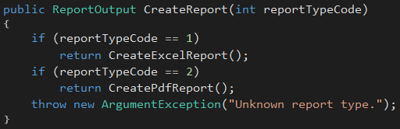
Example
What if we add another report type?
Class is cluttered with a lot of private methods
Single Reponsibility? Nope!

Slide 22
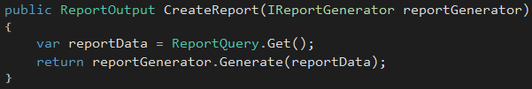
Example
Inheritance is not the only option…
Extend reporting functionality by introducing new IReportGenerator implementations
CreateReport never needs modified

Slide 23
Example
ReportEngine
+ CreateReport
ReportEngine
+ CreateReport
-CreateExcelReport
-CreatePdfReport
IReportGenerator
ExcelGenerator
PdfGenerator
Notes:
Old design required constant change to ReportEngine
New design only requires creation of new classes for new behavior

Slide 24
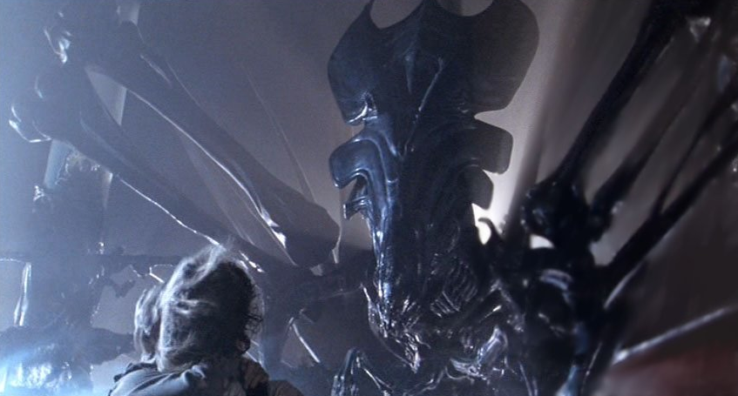
The Kata
Changed requirements for rover
Will be adding missiles
Why does a mars rover need a missile?
This thing →

Slide 25
Part One
Functionality (Already Implemented)
Rovers are equipped with 3 missiles and 3 mortars
Missile’s range is 5 spaces
Missile collides with obstacles in the way
Mortar’s range is 10 spaces
Mortar only collides with obstacles at landing
Collisions destroy obstacles
Non-collisions create indestructible obstacles
Exercise
Open OCP/[Language]_Exercise
Make Projectile class abstract
Create Missile and Mortar subclasses that inherit Projectile
Extract functionality out to classes based on IsMortar
Hint – Projectile should not have IsMortar
Booleans determining functionality are code smells
If a new projectile is added, then the FireProjectile has to be changed in Rover class
20 Minutes
Notes:
SHOW THE APPLICATION!
Make sure to call out that cukes should all be green after they make changes and that these things are already working.
Call out that they should be able to build and run.
Mention that there are unit tests in the project, but only the final solution has good coverage.

Slide 26
Possible Solution
<abstract>
Projectile
MaxRange
Mars
PositionalAdjustments
IsCollisionDetected
Launch
Mortar
MaxRange
IsCollisionDetected
Missile
MaxRange
IsCollisionDetected

Slide 27
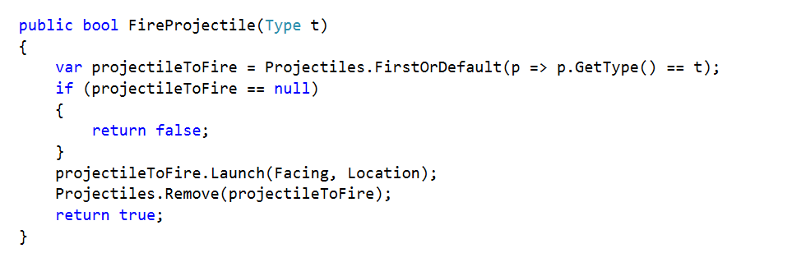
Possible Solution

Slide 28
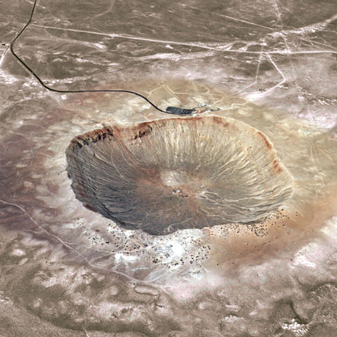
Part Two
Functionality
Obstacles created by a projectile must be indestructible
Exercise
Demonstrate easily adding new obstacle types with additional characteristics
Create a new obstacle type
Hint – Look at picture →
10 Minutes
Notes:
Again call out that everything should build and all tests should be green.

Slide 29
Possible Solution
Obstacle
Location
IsDestructable
Crater
IsDestructable

Slide 30
S.O.L.I.D.
Bio Break…. 10 Minutes

Slide 31
S.O.L.I.D.
Liskov Substitution and Interface Segregation Principles

Slide 32
What is Liskov Substitution?
Wikipedia: if S is a subtype of T, then objects of type T may be replaced (substituted) with objects of type S without altering any of the desirable properties of the software (correctness, task performed, etc.)
Strong behavioral subtyping
Semantic as well as syntactic
Notes:
Can pretty much ignore the long definition

Slide 33
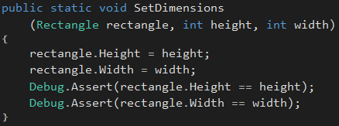
A Violation Example…
Rectangle
int Width
int Height
Square
int Width
int Height
What is wrong with this picture?

Slide 34
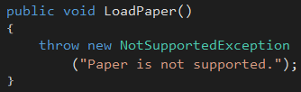
Violation Example #2
Printer
void Print
void LoadPaper
void EjectedPrintedOutput
bool IsReady
InkJetPrinter
LaserPrinter
3DPrinter
LoadPaper?
Notes:
Example of trying to use a common base type, even when all sub types don’t semantically adhere to it.
If you find yourself throwing NotSupportedExceptions, you are probably violating Liskov.

Slide 35
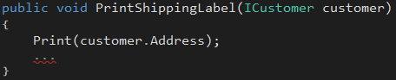
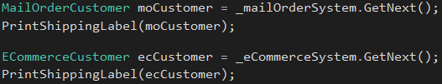
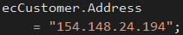
Violation Example #3
ICustomer
int Id
string Address
string City
string State
string Zip
MailOrderCustomer
…
Subscription CatalogSubscription
ECommerceCustomer
…
string UserName
string PasswordHash
Notes:
This is an example where a property is used one way in one context, and another way in another context.
Commonly done, but violates Liskov.
Methods only work when used in certain contexts.

Slide 36
What is Interface Segregation?
Wikipedia: no client should be forced to depend on methods it does not use. ISP splits interfaces which are very large into smaller and more specific ones so that clients will only have to know about the methods that are of interest to them.
Role interfaces
Encourages more broadly applicable interfaces

Slide 37
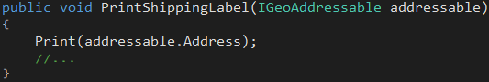
Liskov Violation Example Revisited
IGeoAddressable
ICustomer
MailOrderCustomer
ECommerceCustomer
Employee
Saved by Interface Segregation!

Slide 38
Can you spot all the modeling mistakes?
Bird
void TakeOff
void Land
Sparrow
Ostrich
Penguin
Fish
void Propel
float MaxDepth
FlyingFish
Minnow
StarFish
Notes:
-Ostrich and Penguin can’t fly
-FlyingFish also flies
-StarFish doesn’t swim (ignore that it is not a fish!)
-Penguin

Slide 39
Improved Model
ISwimmable
Bird
IFlyable
Ostrich
Penguin
Fish
Trout
StarFish
Sparrow
FlyingFish
Notes:
Now, code that controls flight is only concerned about members related to flight.
Code that controls swimming doesn’t have to deal with the noise of non-swim related members.
Liskov can be at play now; code related to flight can work regardless of actual type.
Room for improvement; since fish almost always swim, abstract base class SwimmingFish can be introduced

Slide 40
Single Inheritance Languages
Word of caution: Base implementation for multiple interfaces cannot all be inherited
Principle originated in C++, where multiple inheritance is allowed
Dynamic languages can support, or simulate, multiple inheritance
Avoid overly “fat” interfaces
Make good use of helper classes
ISwimmable
BaseFlyable
IFlyable
BaseSwimmable
FlyingFish

Slide 41
Exercise – Aliens Discovered!
Right-click to add aliens to the map, left-click to add standard obstacles
Rover cannot move through aliens, and aliens cannot move through aliens
HINT: Aliens are obstacles
Aliens can be destroyed by missiles and mortars (they are destructible)
Aliens move on each rover command
Aliens move in the exact same way as the rover, only randomly
Forward, Backward, and turning Left or Right

Slide 42
Exercise – Aliens Discovered!
Right-click to add aliens to the map, left-click to add standard obstacles
Rover cannot move through aliens, and aliens cannot move through aliens
HINT: Aliens are obstacles
Aliens can be destroyed by missiles and mortars (they are destructible)
Aliens move on each rover command
Aliens move in the exact same way as the rover, only randomly
Forward, Backward, and turning Left or Right
Instructions
Open LSP+ISP/[Language]_Exercise
Open Solution/MarsCommander.sln and work in MarsRoverKata project
Alien implements the newly introduced IObstacle (Done for you to satisfy the compiler). Implement the members.
Cut movement related members of Rover to abstract base type Movable
Extract IMovable interface from Movable class (see code comments)
Make Rover inherit Movable
Make Alien inherit Movable
Open AlienBehavior and un-comment the code (NOTE: This is the logic that controls alien movement)
Resolve the build errors
BONUS: How might you prevent Rover instances from moving into each other? 30 Minutes

Slide 43
Exercise – Possible Solution
IMovable
Obstacle
IObstacle
Movable
Rover
Alien
Crater

Slide 44
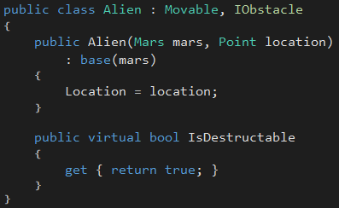
Exercise – Aliens Implementation

Slide 45
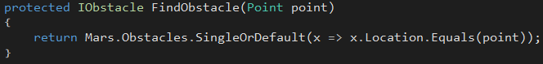
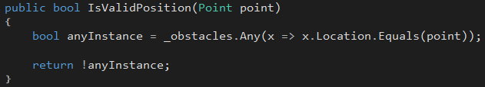
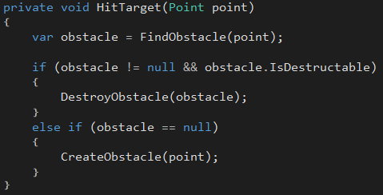
Exercise – Aliens Implementation
LSP:
Aliens are substitutable for Obstacle or Crater
ISP:
Obstacle-detection code knows about minimal interface necessary
Any type can “become” an obstacle

Slide 46
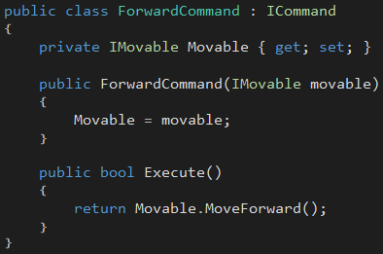
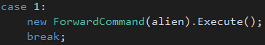
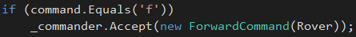
Exercise – Movement Explained
LSP:
Rover and Alien can both be substituted in for any IMovable
ISP:
Movement commands only know about movement-related methods
Any type can take on the characteristics of being “movable”

Slide 47
S.O.L.I.D.
Dependency Inversion Principle
Notes:
Introduction
It is common mistake to assume that this principle deals with Dependency Injection
Who is familiar with Dependency Injection?
The truth is that it does involve Dependency Injection but that is only part of the Principle
Understanding the other half of this principle is key to implementing it properly

Slide 48
High-level modules should not depend on low-level modules. Both should depend on abstractions.
Abstractions should not depend on details. Details should depend on abstractions.
Notes:
So let’s begin with examining what the principle actually says
Read the principle out loud
But what does that mean?

Slide 49
High-level modules should not depend on low-level modules. Both should depend on abstractions.
Abstractions should not depend on details. Details should depend on abstractions.
Notes:
The first part speaks to Dependency Injection and the use of abstractions
So what does that look like?

Slide 50
Computer
Printer
Scanner
Notes:
In a “traditional” architecture, High level components often have a chain of low level dependencies which can have dependencies of their own.
This presents a problem when the chain gets long (or involved) enough that the higher level component only wants some of the functionality of the lower level modules.
They are highly coupled (a bad thing) and code reuse becomes impossible

Slide 51
Instead of this:
Computer
Printer
We want this:
Computer
Printer Interface
Printer

Slide 52
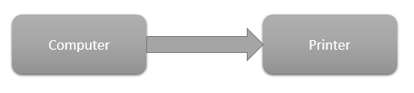
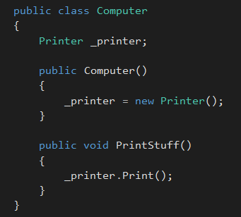
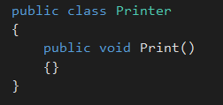
Notes:
Who has seen this type of thing in code they have worked on?
What is wrong with this?

Slide 53
Notes:
In the simplest sense, the internal variable should be an abstraction. This would start to break our dependency on the detail (implementation) but we would still have the concrete instance of the Printer class.

Slide 54
Notes:
One of the logical conclusions here is the need for Dependency Injection but it is important to note that this is not strictly a part of the Dependency Inversion Principle.
However, it is such a common implementation, I feel it is worth touching on here.
The warning signs of a dependency upon low level modules.
* the ‘new’ keyword being used
* variables of the type of implementation instead of an abstraction

Slide 55
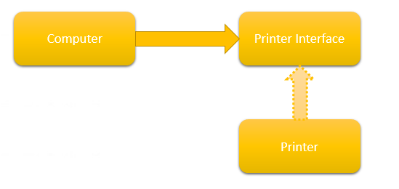
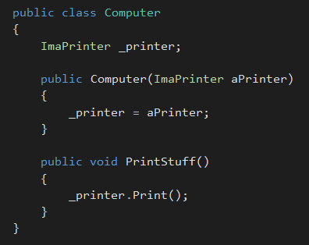
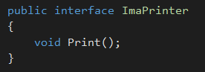
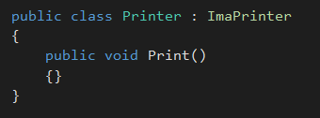
Notes:
So how do we fix this?
By injecting the abstraction into the class we break the hard dependency that it used to have on the implementation.
The implementation being used might still be the Printer class but we can only interact with it through its public interface.

Slide 56
High-level modules should not depend on low-level modules. Both should depend on abstractions.
Abstractions should not depend on details. Details should depend on abstractions.
Notes:
So let’s begin with examining what the principle actually says
Read the principle out loud
But what does that mean?

Slide 57
High-level modules should not depend on low-level modules. Both should depend on abstractions.
Abstractions should not depend on details. Details should depend on abstractions.
Notes:
So let’s begin with examining what the principle actually says
Read the principle out loud
But what does that mean?

Slide 58
Computer
Printer Interface
Printer
Notes:
It is a common & natural mistake to try to apply the interface based on the implementing class.
Most interfaces are born out of a need to have a common contract for existing items
But this is not correct

Slide 59
Computer
Printer Interface
Printer
Notes:
When we say that Details should depend on Abstractions what we are really saying is that the low level component (Detail) should get its marching orders from the high level component via an abstraction.
In short, the consumer of an abstraction is the component that dictates what that abstraction should look like.
In our example above, the COMPUTER (not the Printer) is the component that should dictate what the Printer interface should look like.

Slide 60
Mars Rover Exercise
Notes:
So we have done some of the work for you on this one.

Slide 61
Notes:
So we have done some of the work for you on this one.

Slide 62
Notes:
So we have done some of the work for you on this one.

Slide 63
Notes:
So we have done some of the work for you on this one.

Slide 64
Shooter Behavior Rules
Alien will move three spaces in one direction (chosen randomly)
Alien will turn in random direction
Alien will fire a rocket in that direction
Instructions
Open DIP/[Language]_Exercise
Create new Shooter behavior
Inject this behavior into any Alien that is added using the ‘Shooter’ option
Hint: Use Tracker and WallBuilder as a roadmap
15 Minutes
Notes:
So we have done some of the work for you on this one.

Slide 65

FIN
SOLID empowers you to
Practice makes perfect
https://github.com/PhilipJordan/SOLID
Iterate on /Kata
Notes:
Principles of OO Design - 2003

